Slide 1
Phase of Waves

Slide 2
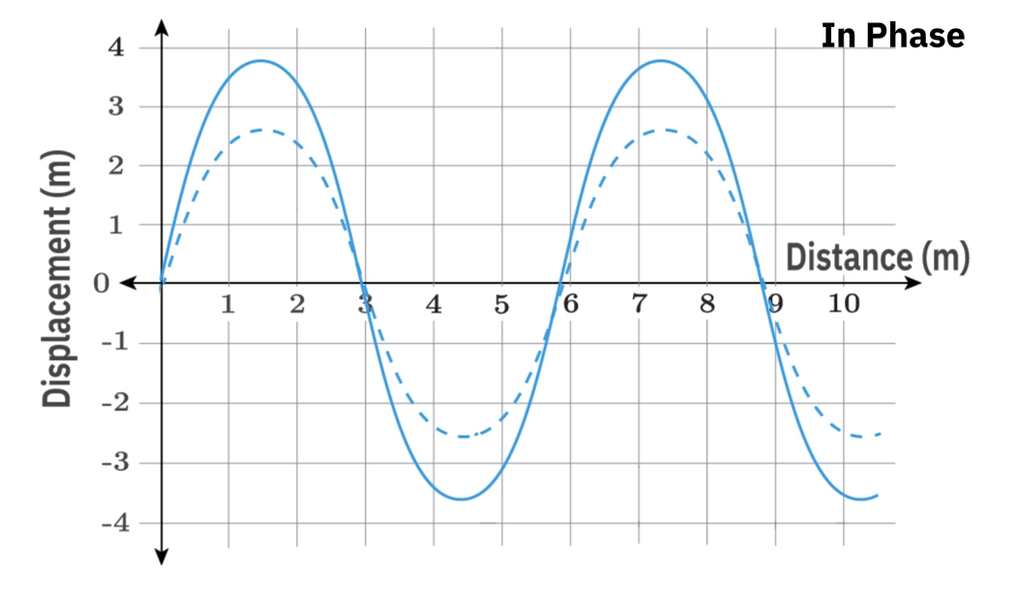
By the end of this lesson you should be able to:
Describe the phase difference between two points on the same wave.
Describe the phase difference between two waves from different sources.
Draw two waves on displacement-distance graphs given their phase difference.

Slide 3
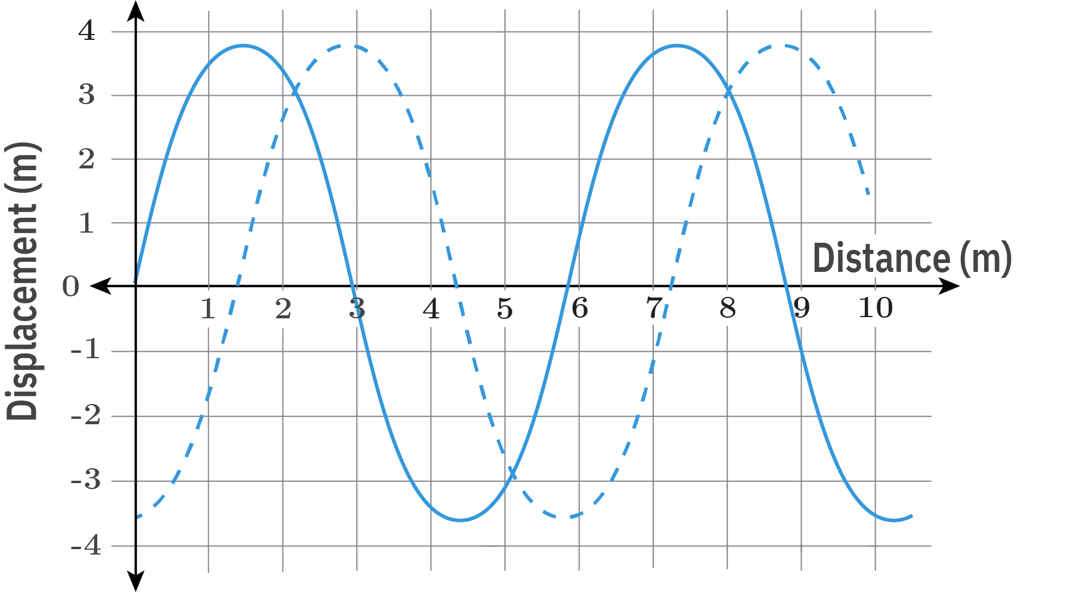
We are now familiar with the basic properties of waves. We know waves undergo repetitive, cyclic motion.
But how do we compare two different waves? We could talk about their respective wavelengths and frequencies, or the speeds at which they travel. But what happens if the waves are identical in these parameters? How would we describe the propagation of one wave relative to another?
This is where phase comes into play! In this lesson we will learn about phase, starting with various points on the same wave and then expanding this definition to compare the propagation of two waves.

Slide 4
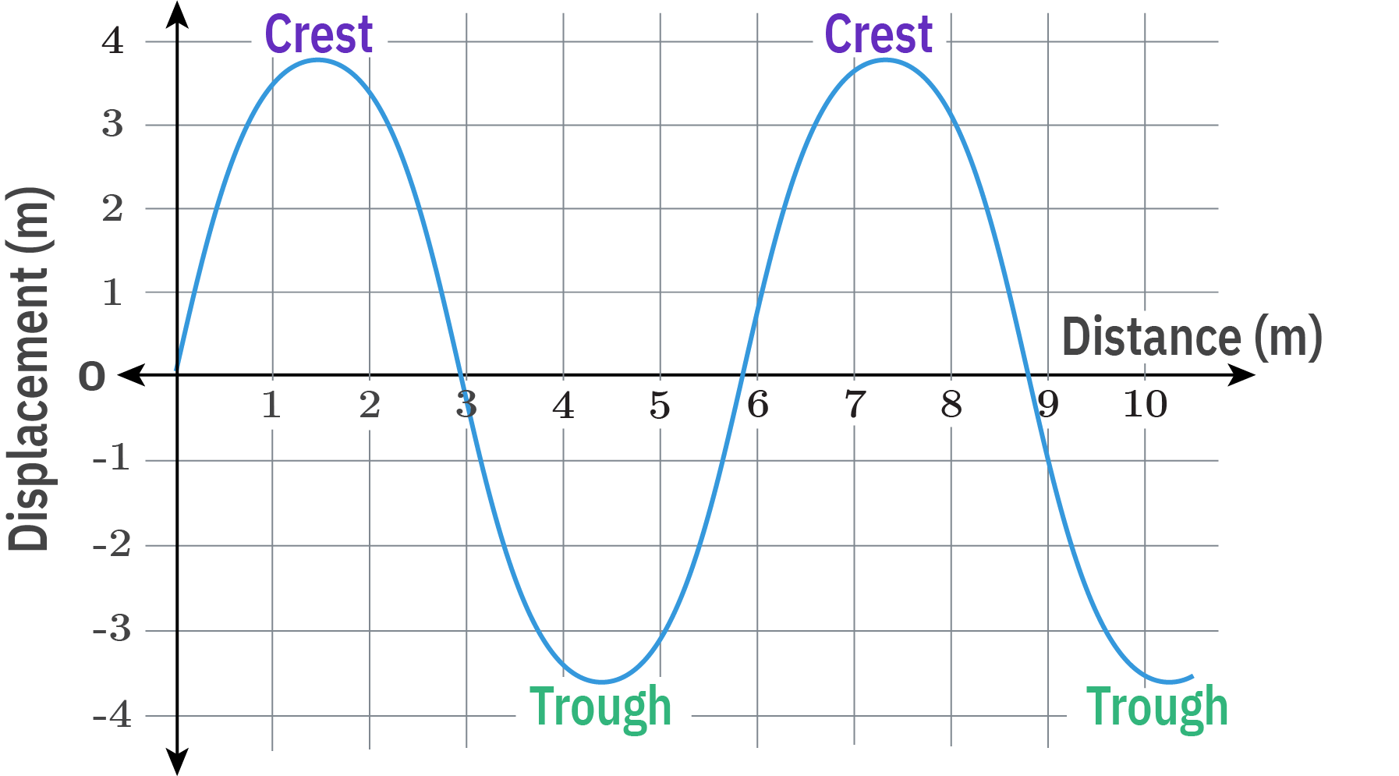
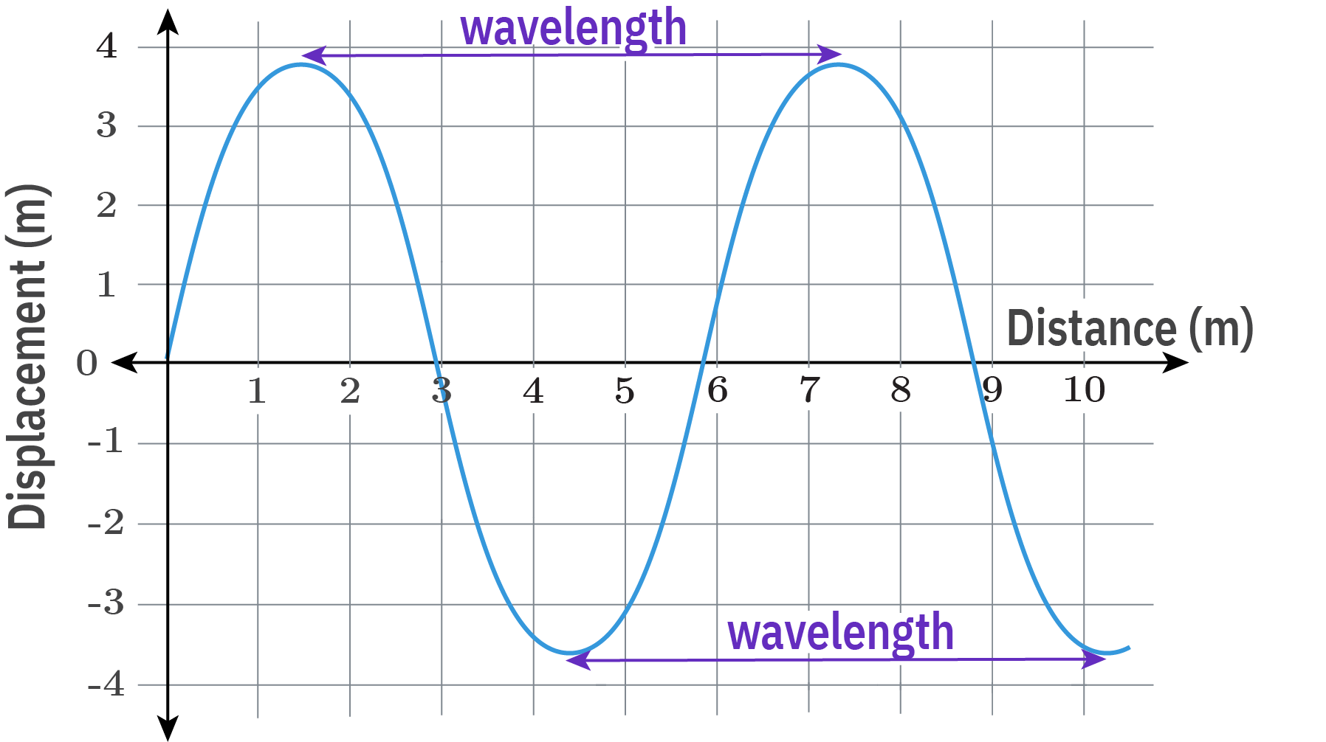
Let's start by considering a single wave on a displacement-distance graph.
There are a few points on the wave that have specific names. The location of maximum positive displacement is said to be a crest while the location of maximum negative displacement is said to be a trough.
The distance between two successive crests (or two successive troughs) is the wavelength of the wave.

Slide 5
We often refer to two successive points on a wave as being two neighbouring points that are undergoing the same motion over time.
However, we can also refer to this as the two points having a phase difference of one wavelength, or being in phase. Points which are in phase undergo the same motion over time.

Slide 6
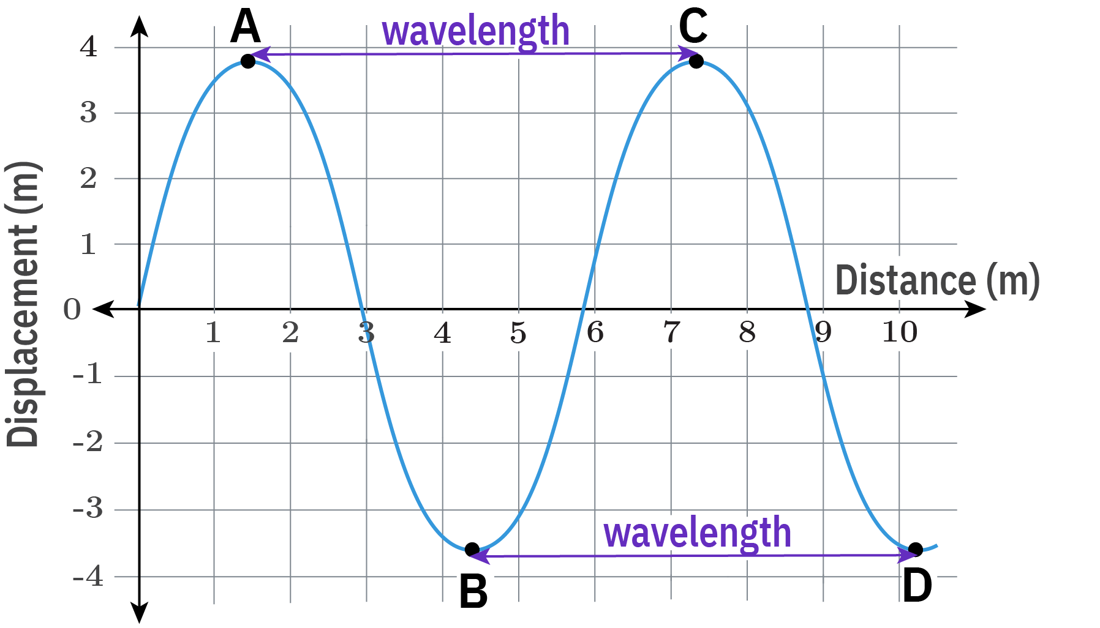
This means any two points on a wave that are one wavelength apart are in phase!
On the graph below the point A is one wavelength away from point C and therefore, points A and C are in phase. Similarly point B is one wavelength away from point D and points B and D are in phase.
As point A moves down, so does point C. Similarly as point B moves up so does point D.

Slide 7
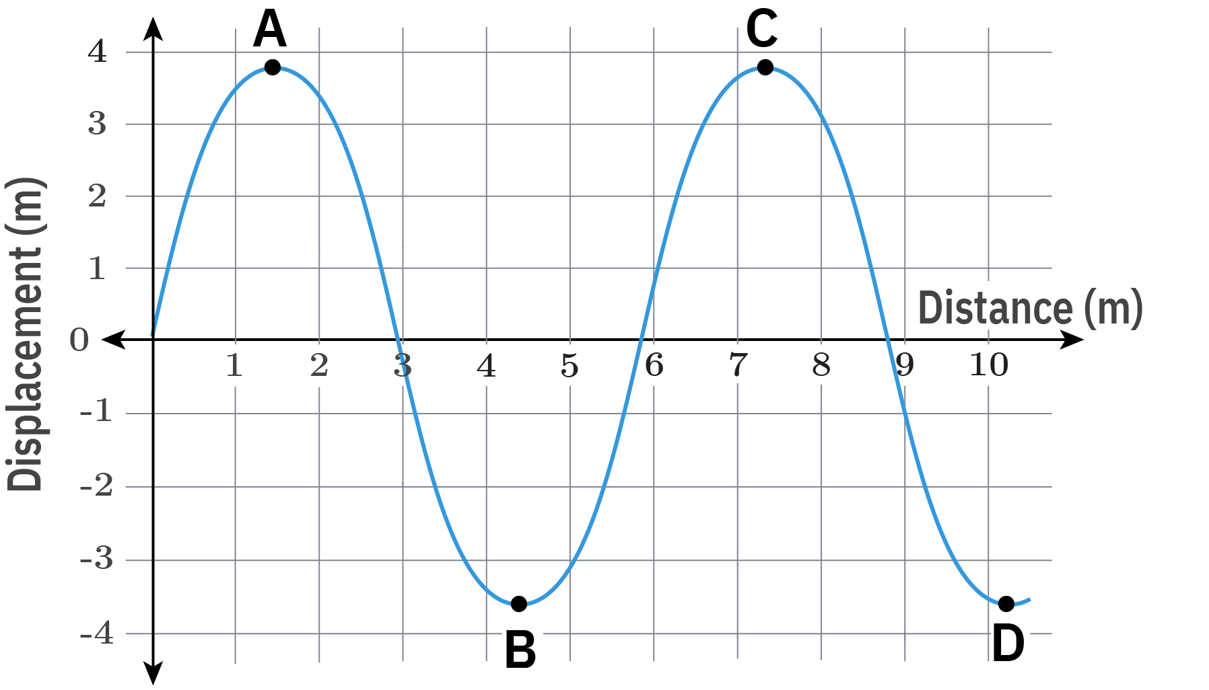
Phase can be measured with reference to the wavelength of the wave or with reference to an angle.
When we use an angle, we state that points on the wave in the same location are separated by 0∘. Points on the wave located one wavelength apart are separated by 360∘. If the points on the wave are located half a wavelength apart then they are separated by 180∘.
We can use any angle or any fraction of wavelengths to describe the phase difference between two points on a wave; however, these are the most common examples you will encounter.

Slide 8
We have seen that two points separated by one wavelength are in phase.
But what happens when points are separated by half of a wavelength (like A and B in the graph below)? A phase difference of half a wavelength or 180∘ is referred to as out of phase. This means the points A and B are out of phase. Similarly the points C and D are out of phase.
These points have the opposite motion over time. As point A moves down, point B will move up!

Slide 9
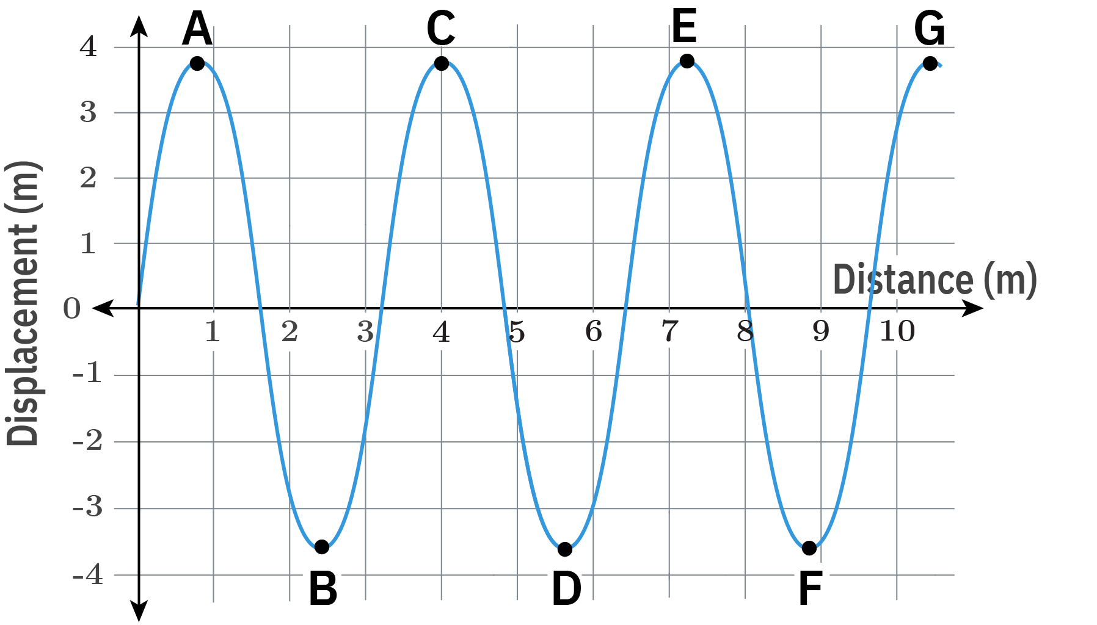
Lastly, let’s consider points that are more than one wavelength apart.
Points that are two wavelengths apart will undergo the same motion over time and so will be in phase. Thus points A and E or points B and F in the diagram are in phase.
Similarly points that are one and a half wavelengths apart, will undergo opposite motion over time and will be out of phase. Thus points A and D or points B and E in the diagram are out of phase.

Slide 10
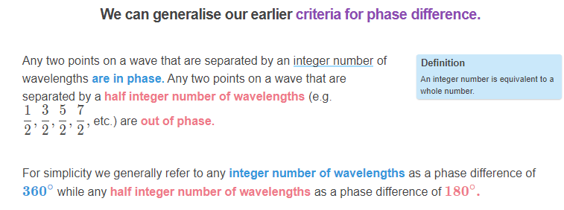

Slide 11
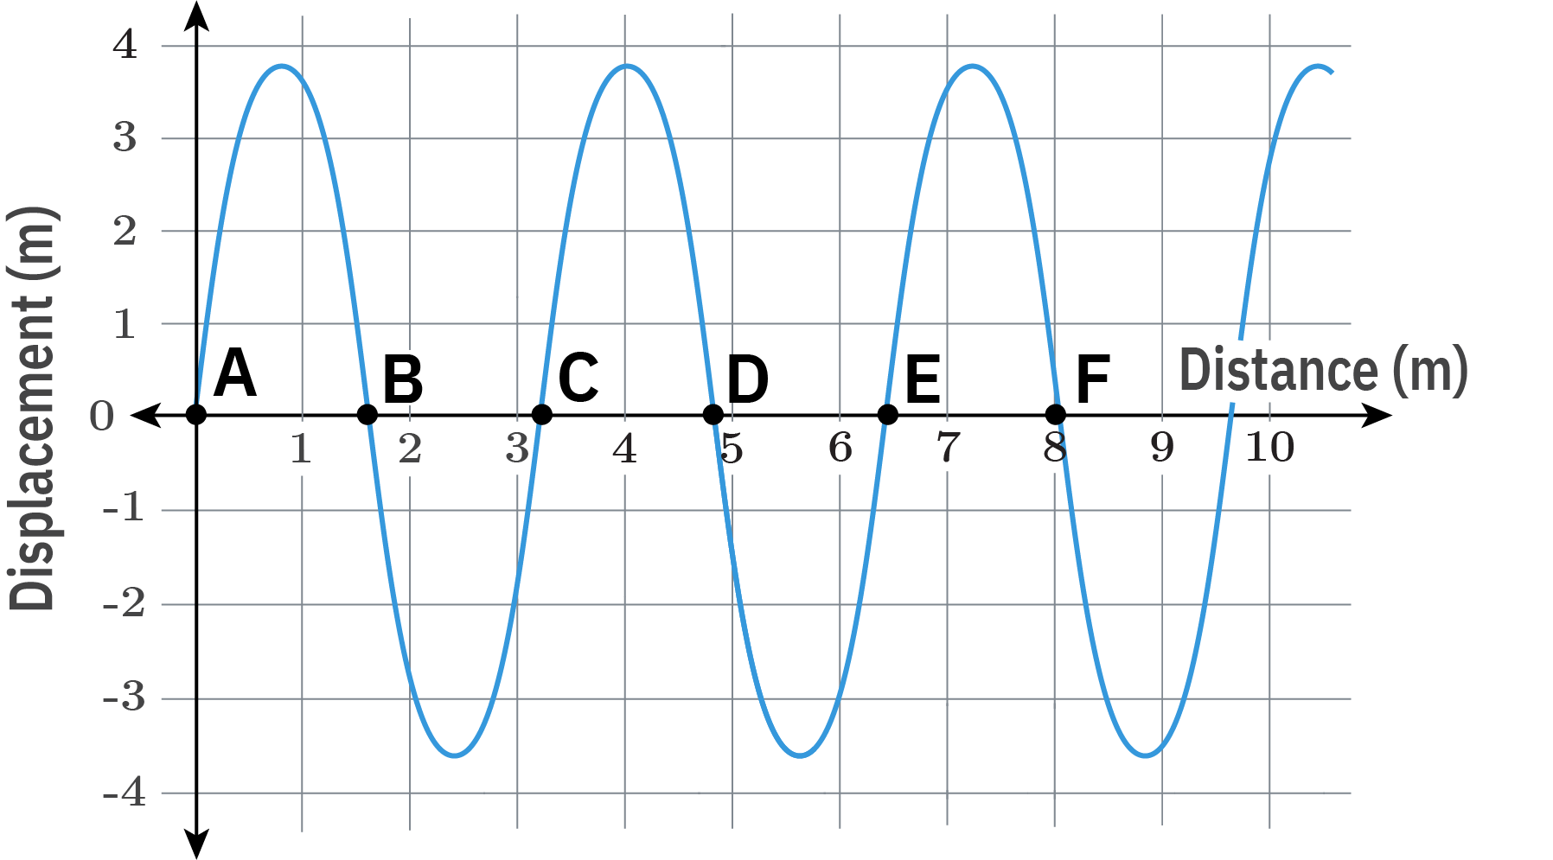
We have explained all of our phase differences in terms of wavelengths or angles.
But you might have noticed that the points on a wave which are in phase occur at the same displacement, while the points on the wave which are out of phase occur at different displacements.
This can be useful as a rule of thumb; however, there is one important exception to the rule. Along the distance axis there are six points which are all at the same displacement. Only three of these points are in phase.
Can you guess which ones?

Slide 12
If you guessed points A, C and E (or B, D and F) then you are correct!
The first clue is that points A, C and E are all an integer number of wavelengths apart while points A and B (or B and C) are a half integer number of wavelengths apart.
However, the real test is to observe the relative motion of each point over time. To be in phase they must undergo the same motion while to be out of phase they must undergo the opposite motion. In the animation below we show how the points will move over time and thus which points are in or out of phase.

Slide 13
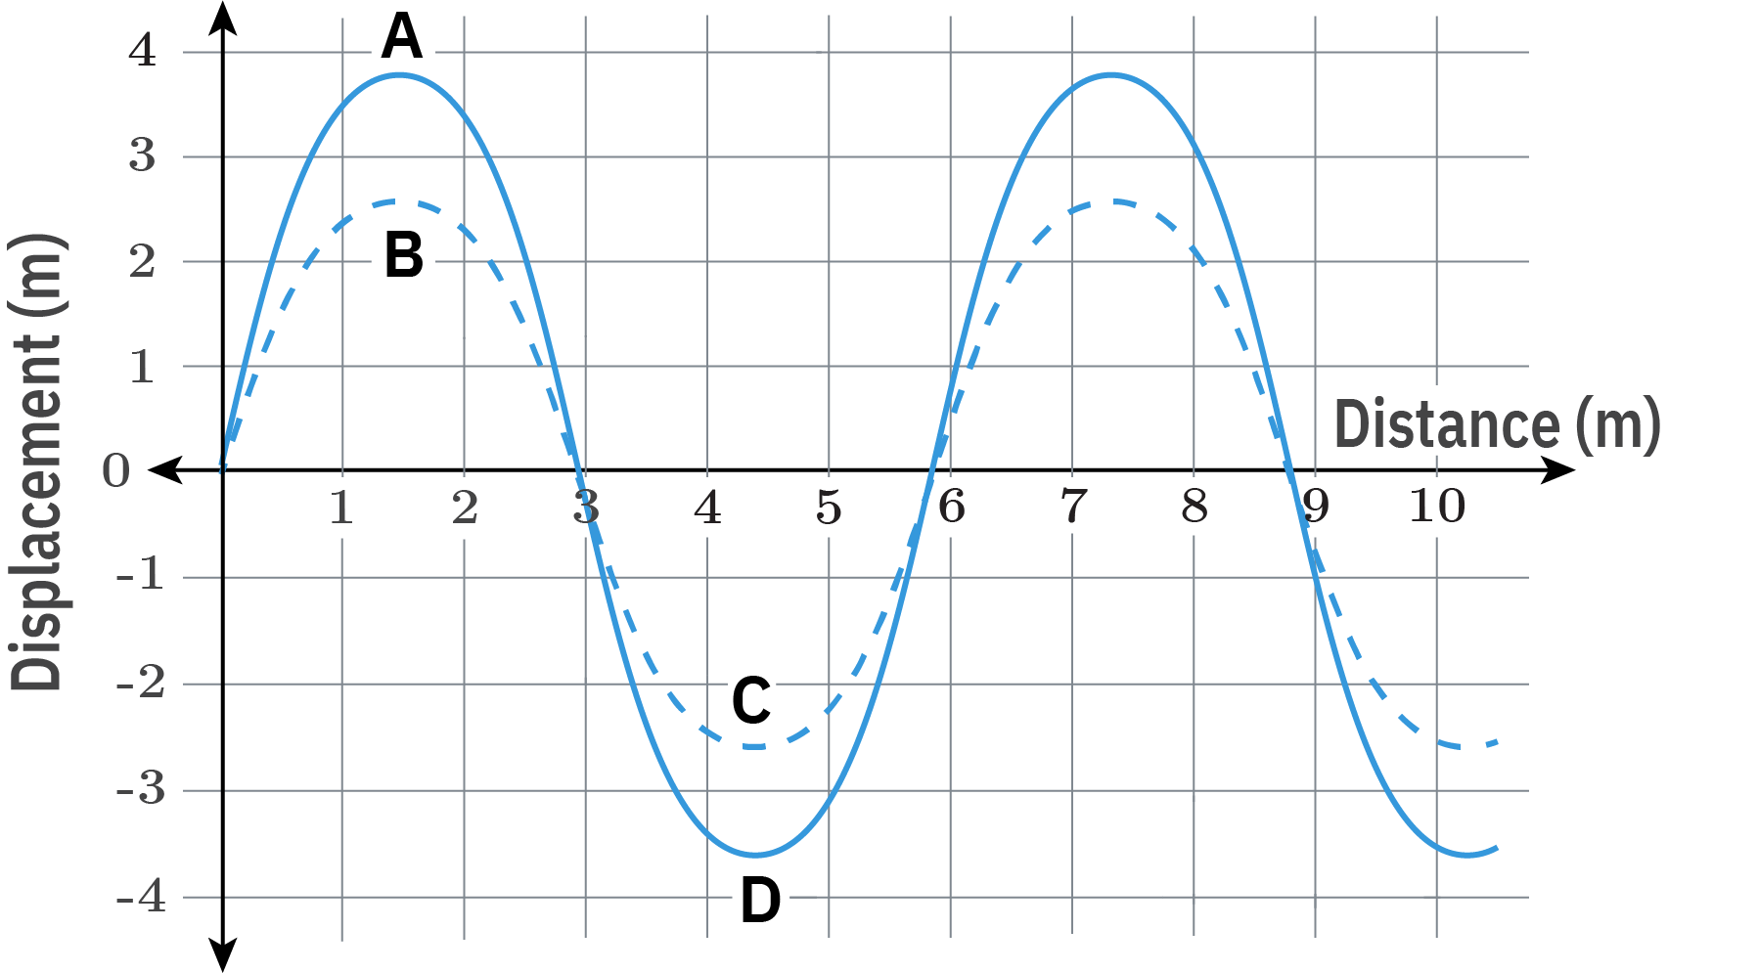
Before we consider the phase difference between two waves, let’s think about what phase difference actually means.
In this lesson we will consider the phase difference of two sources by investigating the relative motion of two points on two waves that are the same distance from their sources. These two waves must have the same frequency and wavelength but do not require the same amplitude.
For example, we would use the points A and B or the points C and D to determine the phase difference between these two waves. However, we can’t use the points A and C to determine the phase difference as these are not the same distance from the source.

Slide 14

To describe the phase difference between two different sources we need the two waves to travel along the same path.
If the two waves travel along different paths then the difference in their relative motion could be due to a phase difference of the source or the different distances that the two waves travelled. The phase difference resulting from the two waves travelling different distances is referred to as a path difference. You can learn more about path differences in the Two Source Interference lesson.
In this lesson we will restrict ourselves to waves that travel along the same path and investigate the phase difference of the wave sources.

Slide 15
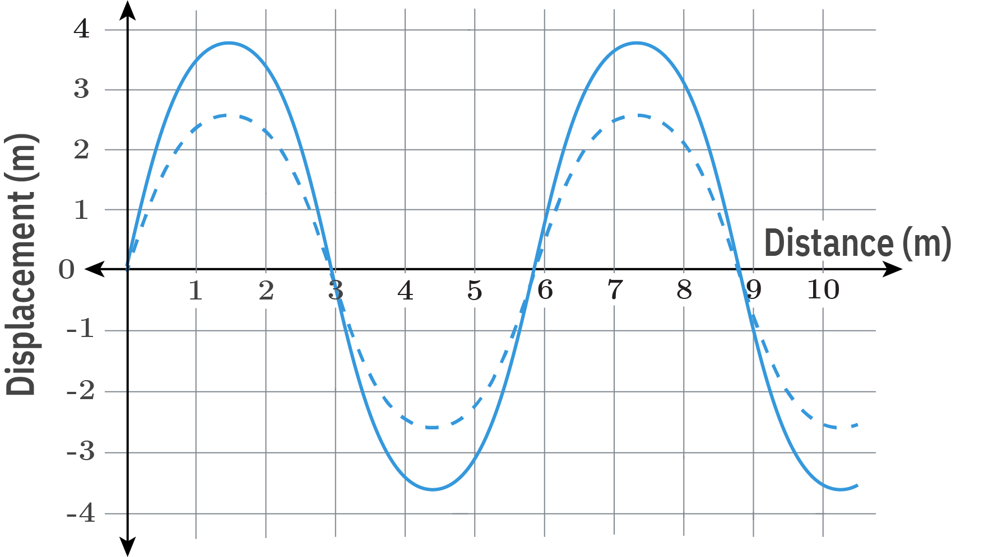
We can now apply our definitions of in and out of phase to two points on different waves.
The best way to check the phase difference of two waves is to draw them both on displacement-distance graphs. Then we can compare points on each wave that are the same distance from the source. If these points undergo the same motion over time then the two waves are in phase.
A quick way to check if two waves are in phase is to see if the crests on one wave occur the same distance from the source as the crests on the other wave (i.e., the crests of the two waves are aligned).

Slide 16
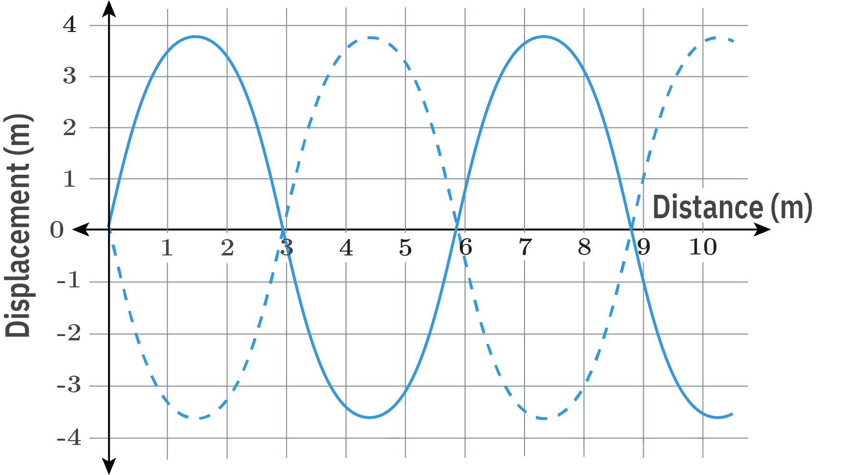
If points that are the same distance from the source undergo the opposite motion over time then they are out of phase.
A quick way to check if two waves are out of phase is to see if the crests on one wave occur the same distance from the source as the troughs on the other wave (i.e., the crests align with the troughs).

Slide 17
When describing the phase difference between two waves we can use both wavelength and angles.
A wave that is displaced by an integer number of wavelengths relative to the other wave will be in phase, or have a phase difference of 360∘.
A wave that is displaced by a half integer number of wavelengths relative to the other wave will be out of phase, or have a phase difference of 180∘.

